Slide 1

Introduction to Evolutionary Computation
Algorithms inspired from darwin’s theory of evolution
<number>

Slide 2
Generic Evolutionary Algorithm
The evolutionary search process is inﬂuenced by the following components of EA:
an encoding of solutions to the problem as a chromosome;
a function to evaluate the fitness, or survival strength of individuals;
initialization of the initial population;
selection operators; and
reproduction operators
<number>

Slide 3
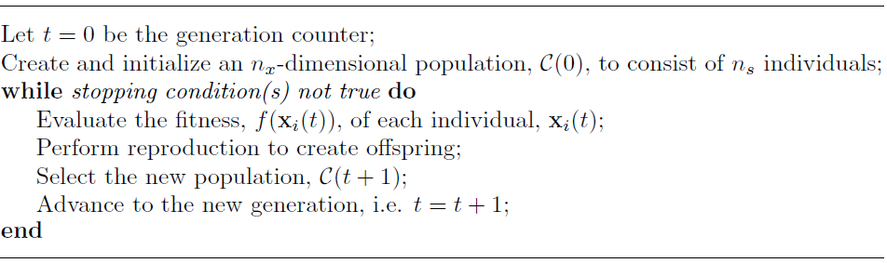
Generic Evolutionary Algorithm
<number>

Slide 4
Evolutionary Computation Paradigms
The different ways in which the EA components are implemented result in different EC paradigms
Genetic algorithms (GAs), which model genetic evolution.
Genetic programming (GP), which is based on genetic algorithms, but individuals are programs (represented as trees).
Evolutionary programming (EP), which is derived from the simulation of adaptive behavior in evolution (i.e. phenotypic evolution).
Evolution strategies (ESs), which are geared toward modeling the strategic parameters that control variation in evolution, i.e. the evolution of evolution.
darvin’s theory of evolution
<number>

Slide 5
Evolutionary Computation Paradigms
Differential evolution (DE), which is similar to genetic algorithms, differing in the reproduction mechanism used.
Cultural evolution (CE), which models the evolution of culture of a population and how the culture influences the genetic and phenotypic evolution of individuals.
Co-evolution (CoE), where initially “dumb” individuals evolve through cooperation, or in competition with one another, acquiring the necessary characteristics to survive.
<number>

Slide 6
Representation – The Chromosome
Each individual represents a candidate solution to an optimization problem
The characteristics of an individual is represented by a chromosome also called as genome
Each variable that needs to be optimized is referred to as a gene, the smallest unit of information
An assignment of a value from the allowed domain of the corresponding variable is referred to as an allele
<number>

Slide 7
Representation – The Chromosome
Characteristics of an individual can be divided into two classes of evolutionary information: genotypes and phenotypes.
A genotype describes the genetic composition of an individual, as inherited from its parents; it represents which allele the individual possesses.
A phenotype is the expressed behavioral traits of an individual in a specific environment; it defines what an individual looks like.
Complex relationships exist between the genotype and phenotype
<number>

Slide 8
Initial Population
Evolutionary algorithms are stochastic, population-based search algorithms.
Each EA maintains a population of candidate solutions.
The first step in applying an EA to solve an optimization problem is to generate an initial population.
The standard way of generating an initial population is to assign a random value from the allowed domain to each of the genes of each chromosome.
The goal of random selection is to ensure that the initial population is a uniform representation of the entire search space.
<number>

Slide 9
Initial Population
Large numbers of individuals increase diversity, thereby improving the exploration abilities of the population.
Larger population size increase the computational complexity per generation.
With larger population size, it may be the case that fewer generations are needed to locate an acceptable solution.
A small population, represents a small part of the search space.
While the time complexity per generation is low, the EA may need more generations to converge.
<number>
Notes:
<number>

Slide 10
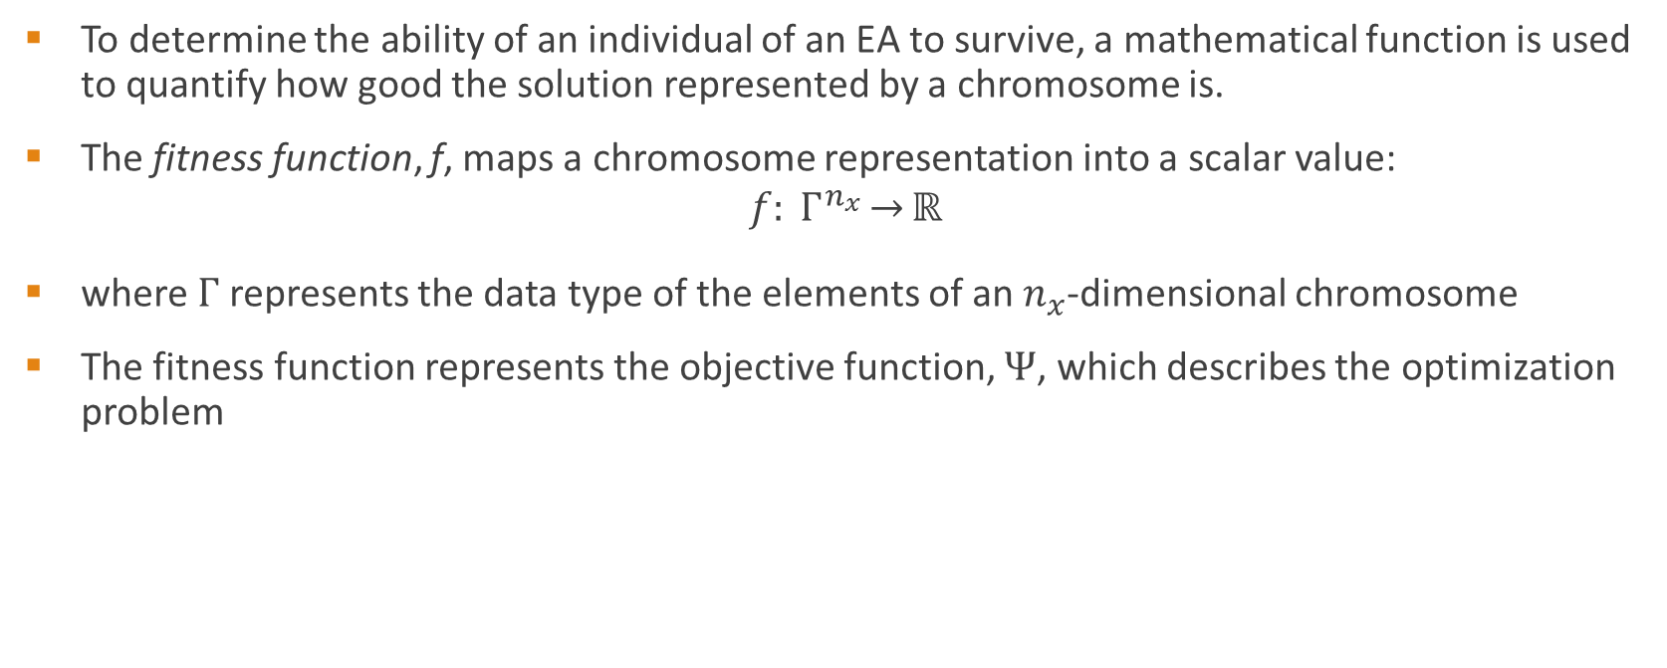
Fitness Function
<number>

Slide 11
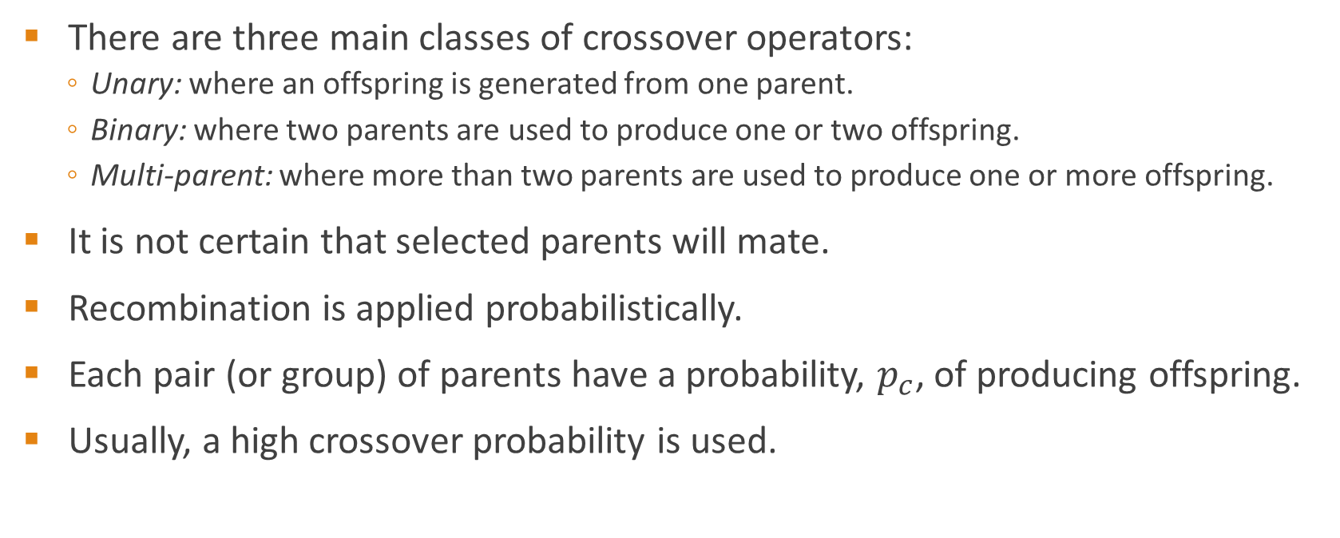
Crossover
<number>

Slide 12
Crossover
In selection of parents, the following issues need to be considered:
It may happen that the same individual is selected as both parents. The parent selection process should therefore incorporate a test to prevent such operations.
It is also possible that the same individual takes part in more than one application of the crossover operator. This becomes a problem when fitness-proportional selection schemes are used.
<number>

Slide 13

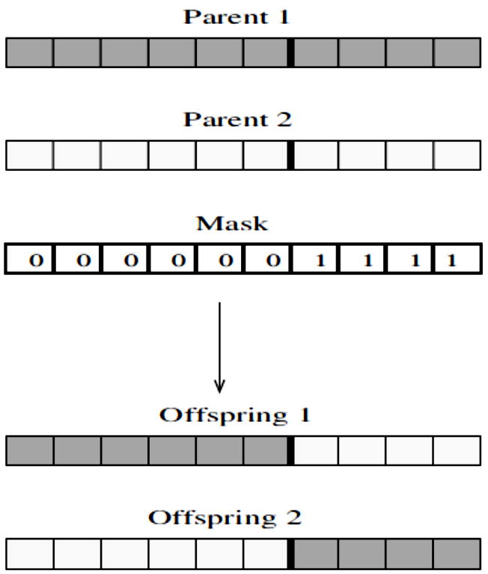
One-point crossover
A one-point crossover operator was developed that randomly selects a crossover point, and the bitstrings after that point are swapped between the two parents.
<number>

Slide 14
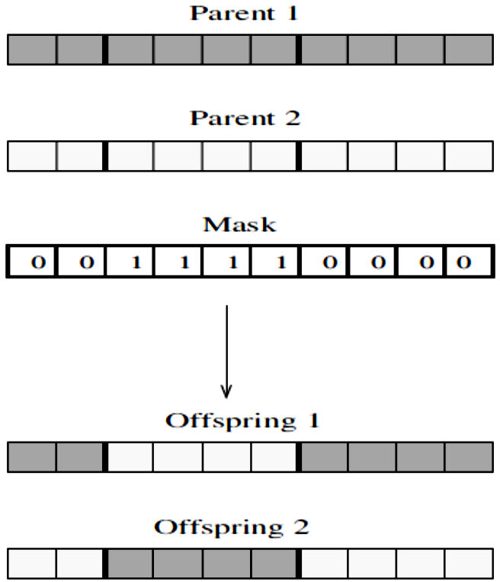
Two-point crossover
two bit positions are randomly selected, and the bitstrings between these points are swapped
<number>

Slide 15
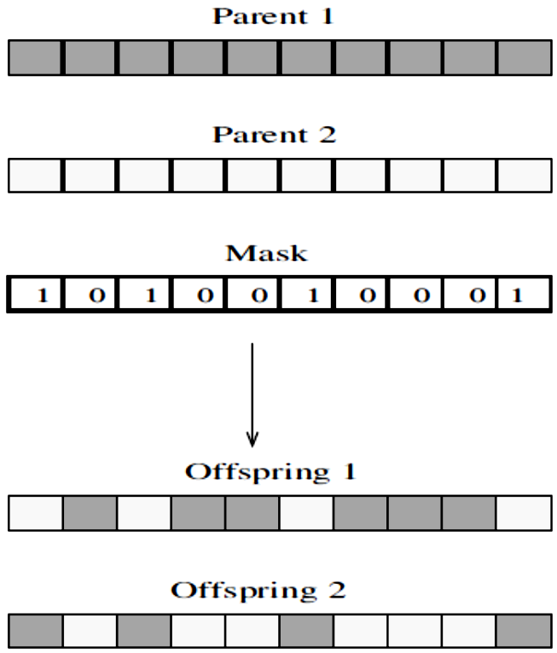
Uniform crossover
The nx-dimensional mask is created randomly.
Here, px is the bit-swapping probability.
<number>

Slide 16
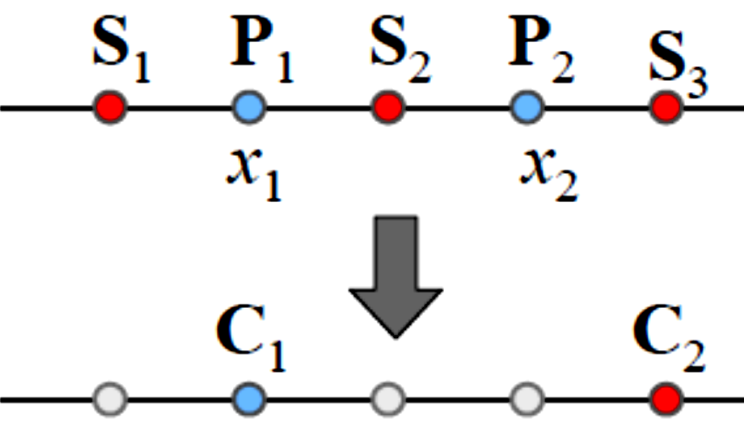
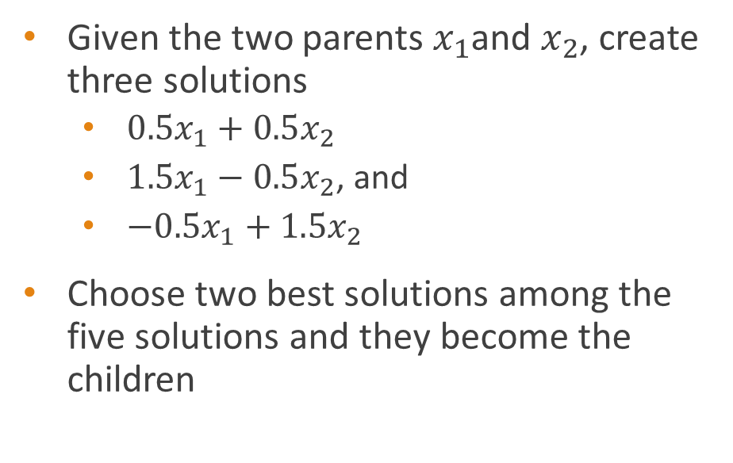
Linear Crossover
<number>

Slide 17

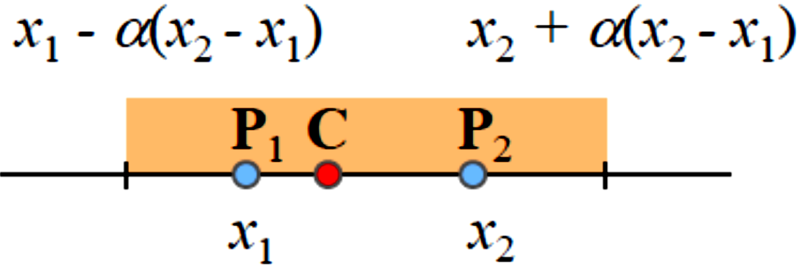
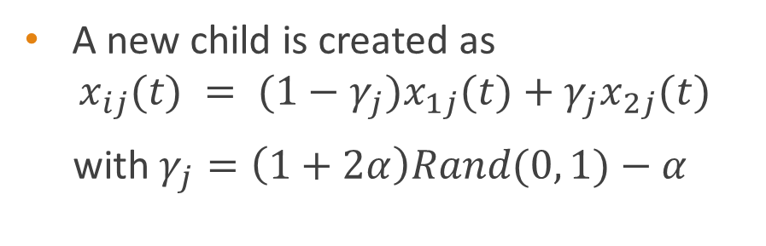
<number>

Slide 18
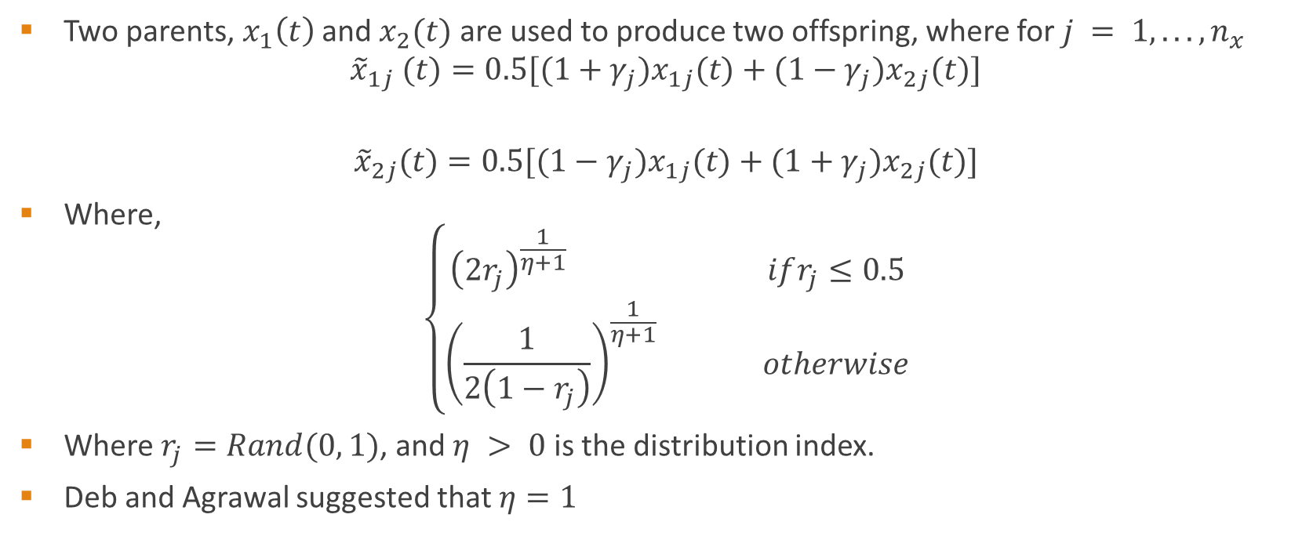
Simulated Binary Crossover (SBX)
<number>

Slide 19
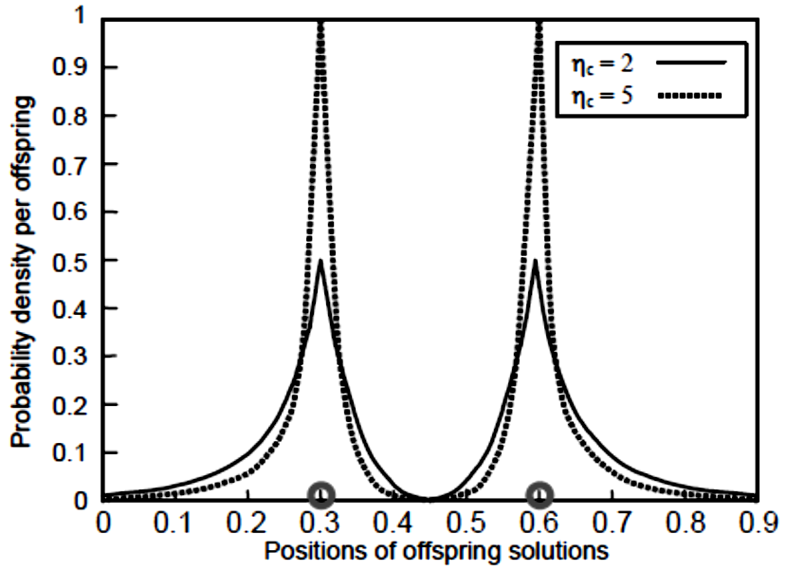
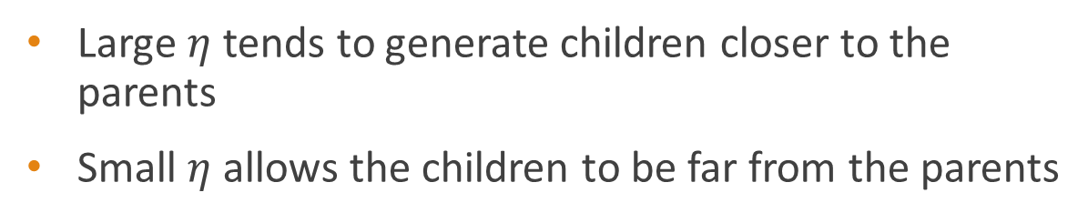
Simulated Binary Crossover (SBX)
<number>

Slide 20
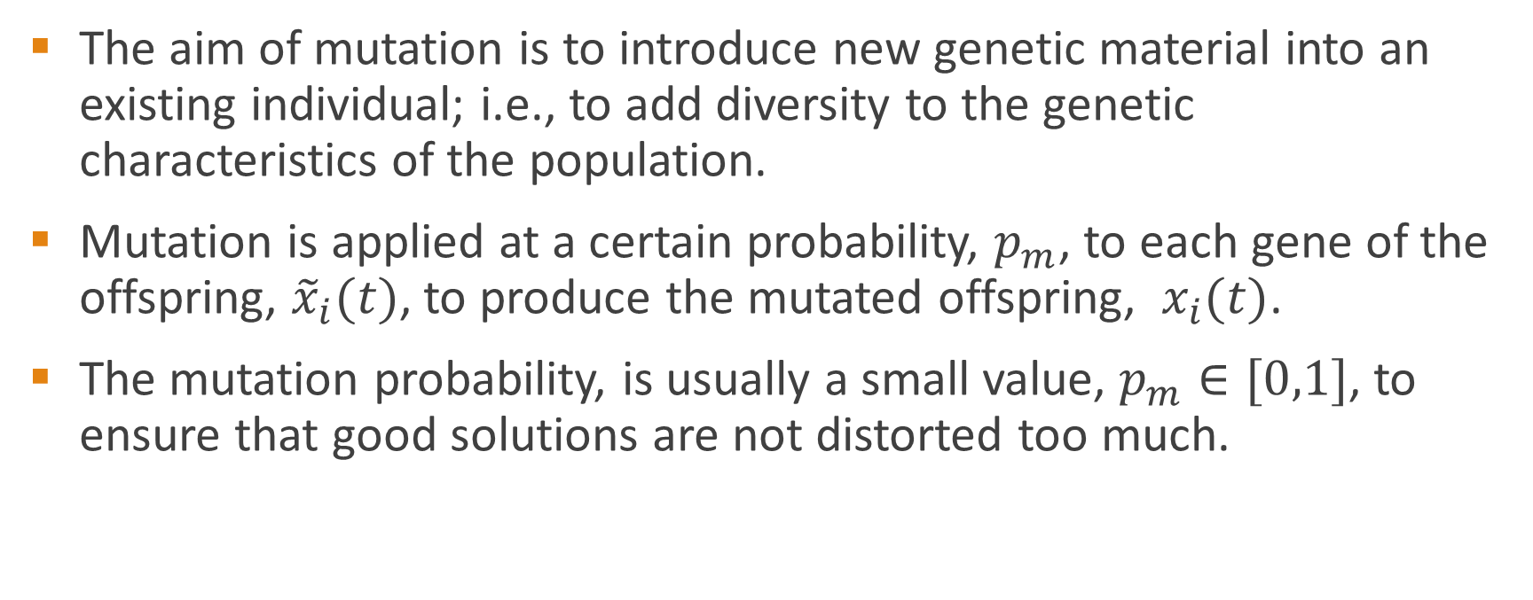
Mutation
<number>

Slide 21
Random Mutation
Random mutation generates a solution randomly within the entire parameter range
Generated solution has no relationship to the original solution
<number>

Slide 22
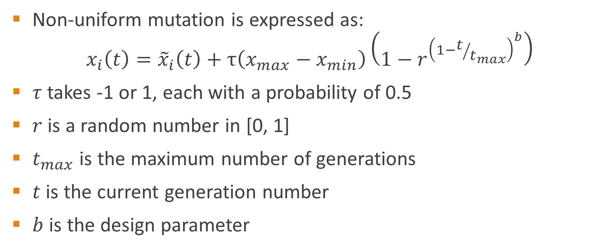
Non-Uniform Mutation
<number>

Slide 23
Non-Uniform Mutation
Mutated solution is more likely to be close to the original solution
As the generation number increases, mutated solutions are generated closer to the original solution
Illegal mutated gene values are adjusted to make them feasible, that is, within the allowed range
<number>

